Slide 1
Rationale Management
Lauren DiCristofaro
Abdulkarim Egal
Vishal Patel

Slide 2
Goals for the sprint
Additional UI changes to have rationale dialog box reflect UI document
Create DB document for rationale table along with SQL script
Modify Promote page to display rationale data
Backend support for storing into rationale table and reading from rationale table

Slide 3
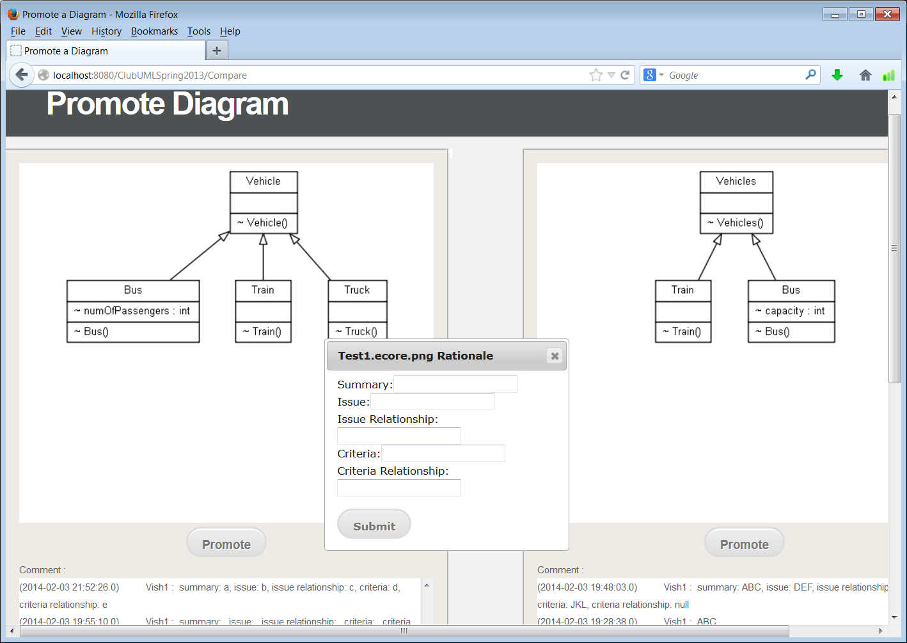

Slide 4
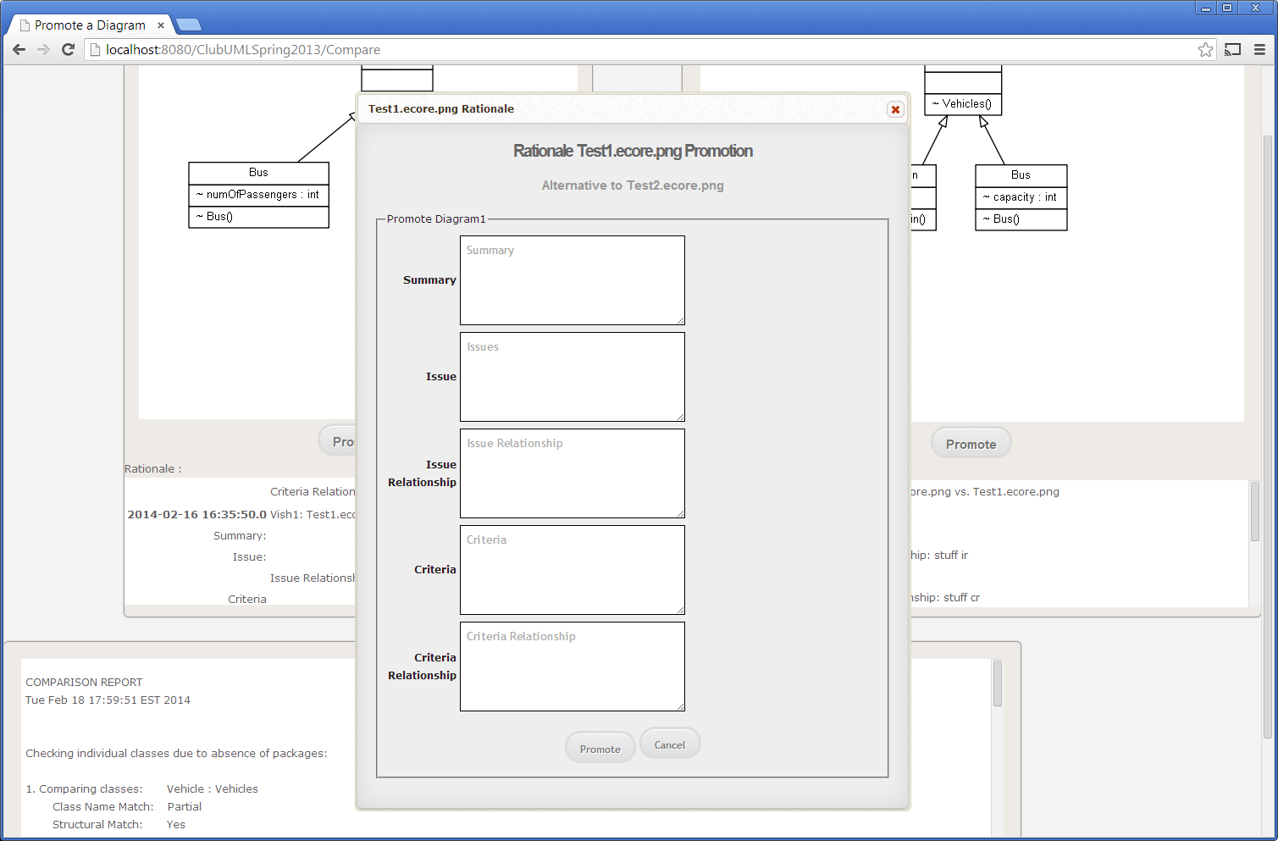

Slide 6
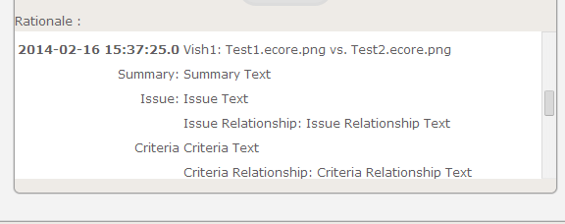

Slide 7
Changes Made
promote.jsp
new rationale dialog box changes
new displaying rationale info
promote_style.css
Style for newly formatted rationale dialog box
Compare.java
changes to read rationale info from DB and load onto page

Slide 8
Changes Made
Promote.java
Store rationale data invoking rationale DAO
Rationale.java
Minor change to add username to object
RationaleDAO.java
Newly added DB access object for rationale table

